Slide 1
Compose Input: A Demonstration of Text Input and Validation with Android Compose
Name:Suresh.S
Reg.No:710422104059

Slide 2
Description
"Compose Input: A Demonstration of Text Input and Validation with Android Compose" refers to showcasing how to implement and manage user input fields using Jetpack Compose, Google's modern toolkit for building native UI in Android applications. This topic typically includes demonstrating how to:
1. Create Text Input Fields
Use the TextField or OutlinedTextField components to allow users to enter text.
Customize these fields with labels, placeholders, and icons.
2. Handle State and Input Changes
Utilize remember and mutableStateOf to manage the state of input fields.
Update UI dynamically as the user types.
3. Implement Validation
Validate user inputs such as email formats, passwords, or other criteria.
Display error messages or feedback directly below the input field if validation fails.
4. Enhance Usability
Add features like:
Input masking (e.g., phone numbers or credit card formatting).
Keyboard actions to move between fields or submit forms.
Clear buttons or focus management for user convenience.
5. Styling and Customization
Apply custom themes and styles to input fields.
Adjust colors, fonts, and dimensions to fit the app’s design.

Slide 3
AdminActivity.kt
package com.example.surveyapplication
import android.os.Bundle
import android.util.Log
import androidx.activity.ComponentActivity
import androidx.activity.compose.setContent
import androidx.compose.foundation.Image
import androidx.compose.foundation.layout.*
import androidx.compose.foundation.lazy.LazyColumn
import androidx.compose.foundation.lazy.LazyRow
import androidx.compose.foundation.lazy.items
import androidx.compose.material.MaterialTheme
import androidx.compose.material.Surface
import androidx.compose.material.Text
import androidx.compose.runtime.Composable
import androidx.compose.ui.Modifier
import androidx.compose.ui.graphics.Color
import androidx.compose.ui.layout.ContentScale
import androidx.compose.ui.res.painterResource
import androidx.compose.ui.tooling.preview.Preview
import androidx.compose.ui.unit.dp
import androidx.compose.ui.unit.sp
import com.example.surveyapplication.ui.theme.SurveyApplicationTheme
class AdminActivity : ComponentActivity() {
private lateinit var databaseHelper: SurveyDatabaseHelper
override fun onCreate(savedInstanceState: Bundle?) {
super.onCreate(savedInstanceState)
databaseHelper = SurveyDatabaseHelper(this)
setContent {
val data = databaseHelper.getAllSurveys();
Log.d("swathi", data.toString())
val survey = databaseHelper.getAllSurveys()
ListListScopeSample(survey)
} } }

Slide 4
@Composable
fun ListListScopeSample(survey: List<Survey>) {
Image(
painterResource(id = R.drawable.background), contentDescription = "",
alpha =0.1F,
contentScale = ContentScale.FillHeight,
modifier = Modifier.padding(top = 40.dp) )
Text(
text = "Survey Details",
modifier = Modifier.padding(top = 24.dp, start = 106.dp, bottom = 24.dp),
fontSize = 30.sp,
color = Color(0xFF25b897) )
Spacer(modifier = Modifier.height(30.dp))
LazyRow(
modifier = Modifier
.fillMaxSize()
.padding(top = 80.dp),
horizontalArrangement = Arrangement.SpaceBetween ) {
item {
LazyColumn {
items(survey) { survey ->
Column(
modifier = Modifier.padding(
top = 16.dp,
start = 48.dp,
bottom = 20.dp
)
) {
Text("Name: ${survey.name}")
Text("Age: ${survey.age}")
Text("Mobile_Number: ${survey.mobileNumber}")
Text("Gender: ${survey.gender}")
Text("Diabetics: ${survey.diabetics}")
} } } } } }

Slide 5
LoginActivity.kt
package com.example.surveyapplication
import android.content.Context
import android.content.Intent
import android.os.Bundle
import androidx.activity.ComponentActivity
import androidx.activity.compose.setContent
import androidx.compose.foundation.Image
import androidx.compose.foundation.background
import androidx.compose.foundation.layout.*
import androidx.compose.material.*
import androidx.compose.runtime.*
import androidx.compose.ui.Alignment
import androidx.compose.ui.Modifier
import androidx.compose.ui.graphics.Color
import androidx.compose.ui.layout.ContentScale
import androidx.compose.ui.res.painterResource
import androidx.compose.ui.text.font.FontFamily
import androidx.compose.ui.text.font.FontWeight
import androidx.compose.ui.tooling.preview.Preview
import androidx.compose.ui.unit.dp
import androidx.compose.ui.unit.sp
import androidx.core.content.ContextCompat
import com.example.surveyapplication.ui.theme.SurveyApplicationTheme
class LoginActivity : ComponentActivity() {
private lateinit var databaseHelper: UserDatabaseHelper
override fun onCreate(savedInstanceState: Bundle?) { super.onCreate(savedInstanceState)
databaseHelper = UserDatabaseHelper(this)
setContent { LoginScreen(this, databaseHelper) } } }
@Composable
fun LoginScreen(context: Context, databaseHelper: UserDatabaseHelper) {
var username by remember { mutableStateOf("") }
var password by remember { mutableStateOf("") }
var error by remember { mutableStateOf("") }

Slide 6
Column(
modifier = Modifier.fillMaxSize().background(Color.White),
horizontalAlignment = Alignment.CenterHorizontally,
verticalArrangement = Arrangement.Center
) {
Image(painterResource(id = R.drawable.survey_login), contentDescription = "")
Text(
fontSize = 36.sp,
fontWeight = FontWeight.ExtraBold,
fontFamily = FontFamily.Cursive,
color = Color(0xFF25b897),
text = "Login" )
Spacer(modifier = Modifier.height(10.dp))
TextField(
value = username,
onValueChange = { username = it },
label = { Text("Username") },
modifier = Modifier
.padding(10.dp)
.width(280.dp) )
TextField(
value = password,
onValueChange = { password = it },
label = { Text("Password") },
visualTransformation = PasswordVisualTransformation(),
modifier = Modifier
.padding(10.dp)
.width(280.dp)
)
if (error.isNotEmpty()) {
Text(
text = error,
color = MaterialTheme.colors.error,
modifier = Modifier.padding(vertical = 16.dp)
)
}

Slide 7
Button(
onClick = {
if (username.isNotEmpty() && password.isNotEmpty()) {
val user = databaseHelper.getUserByUsername(username)
if (user != null && user.password == password) {
error = "Successfully log in"
context.startActivity(
Intent(
context,
MainActivity::class.java ) )
//onLoginSuccess() }
if (user != null && user.password == "admin") {
error = "Successfully log in"
context.startActivity(
Intent(
context,
AdminActivity::class.java ) ) }
else {
error = "Invalid username or password } } else {
error = "Please fill all fields } },
colors = ButtonDefaults.buttonColors(backgroundColor = Color(0xFF84adb8)),
modifier = Modifier.padding(top = 16.dp) ) {
Text(text = "Login") }
Row {
TextButton(onClick = {context.startActivity(
Intent(
context,
RegisterActivity::class.java ) )} )
{ Text(color = Color(0xFF25b897),text = "Register") }
TextButton(onClick = { }) {
Spacer(modifier = Modifier.width(60.dp))
Text(color = Color(0xFF25b897),text = "Forget password?") } } }}
private fun startMainPage(context: Context) {
val intent = Intent(context, MainActivity::class.java)
ContextCompat.startActivity(context, intent, null)
}

Slide 8
MainActivity.kt
package com.example.surveyapplication
import android.content.Context
import android.content.Intent
import android.os.Bundle
import androidx.activity.ComponentActivity
import androidx.activity.compose.setContent
import androidx.compose.foundation.Image
import androidx.compose.foundation.layout.*
import androidx.compose.material.*
import androidx.compose.runtime.*
import androidx.compose.ui.Alignment
import androidx.compose.ui.Modifier
import androidx.compose.ui.graphics.Color
import androidx.compose.ui.layout.ContentScale
import androidx.compose.ui.res.painterResource
import androidx.compose.ui.text.style.TextAlign
import androidx.compose.ui.tooling.preview.Preview
import androidx.compose.ui.unit.dp
import androidx.compose.ui.unit.sp
import com.example.surveyapplication.ui.theme.SurveyApplicationTheme
class MainActivity : ComponentActivity() {
private lateinit var databaseHelper: SurveyDatabaseHelper
override fun onCreate(savedInstanceState: Bundle?) {
super.onCreate(savedInstanceState)
databaseHelper = SurveyDatabaseHelper(this)
setContent {
FormScreen(this, databaseHelper)
}
}
}

Slide 9
@Composable
fun FormScreen(context: Context, databaseHelper: SurveyDatabaseHelper) {
Image(
painterResource(id = R.drawable.background), contentDescription = "",
alpha =0.1F,
contentScale = ContentScale.FillHeight,
modifier = Modifier.padding(top = 40.dp)
)
// Define state for form fields
var name by remember { mutableStateOf("") }
var age by remember { mutableStateOf("") }
var mobileNumber by remember { mutableStateOf("") }
var genderOptions = listOf("Male", "Female", "Other")
var selectedGender by remember { mutableStateOf("") }
var error by remember { mutableStateOf("") }
var diabeticsOptions = listOf("Diabetic", "Not Diabetic")
var selectedDiabetics by remember { mutableStateOf("") }
Column(
modifier = Modifier.padding(24.dp),
horizontalAlignment = Alignment.Start,
verticalArrangement = Arrangement.SpaceEvenly
) {
Text(
fontSize = 36.sp,
textAlign = TextAlign.Center,
text = "Survey on Diabetics",
color = Color(0xFF25b897)
)

Slide 10
Spacer(modifier = Modifier.height(24.dp))
Text(text = "Name :", fontSize = 20.sp)
TextField(
value = name,
onValueChange = { name = it },
)
Spacer(modifier = Modifier.height(14.dp))
Text(text = "Age :", fontSize = 20.sp)
TextField(
value = age,
onValueChange = { age = it },
)
Spacer(modifier = Modifier.height(14.dp))
Text(text = "Mobile Number :", fontSize = 20.sp)
TextField(
value = mobileNumber,
onValueChange = { mobileNumber = it },
)
Spacer(modifier = Modifier.height(14.dp))
Text(text = "Gender :", fontSize = 20.sp)
RadioGroup(
options = genderOptions,
selectedOption = selectedGender,
onSelectedChange = { selectedGender = it }
)
Spacer(modifier = Modifier.height(14.dp))
Text(text = "Diabetics :", fontSize = 20.sp)
RadioGroup(
options = diabeticsOptions,
selectedOption = selectedDiabetics,
onSelectedChange = { selectedDiabetics = it } )
Text(
text = error,
textAlign = TextAlign.Center,
modifier = Modifier.padding(bottom = 16.dp)
)

Slide 11
// Display Submit button
Button(
onClick = { if (name.isNotEmpty() && age.isNotEmpty() && mobileNumber.isNotEmpty() && genderOptions.isNotEmpty() && diabeticsOptions.isNotEmpty()) {
val survey = Survey(
id = null,
name = name,
age = age,
mobileNumber = mobileNumber,
gender = selectedGender,
diabetics = selectedDiabetics )
databaseHelper.insertSurvey(survey)
error = "Survey Completed"
} else {
error = "Please fill all fields" } },
colors = ButtonDefaults.buttonColors(backgroundColor = Color(0xFF84adb8)),
modifier = Modifier.padding(start = 70.dp).size(height = 60.dp, width = 200.dp) ) {
Text(text = "Submit") } } }
@Composable
fun RadioGroup(
options: List<String>,
selectedOption: String?,
onSelectedChange: (String) -> Unit) {
Column {
options.forEach { option ->
Row(
Modifier
.fillMaxWidth()
.padding(horizontal = 5.dp) ) {
RadioButton(
selected = option == selectedOption,
onClick = { onSelectedChange(option) } )
Text(
text = option,
style = MaterialTheme.typography.body1.merge(),
modifier = Modifier.padding(top = 10.dp),
fontSize = 17.sp ) } } }}

Slide 12
RegisterActivity.kt
package com.example.surveyapplication
import android.content.Context
import android.content.Intent
import android.os.Bundle
import androidx.activity.ComponentActivity
import androidx.activity.compose.setContent
import androidx.compose.foundation.Image
import androidx.compose.foundation.background
import androidx.compose.foundation.layout.*
import androidx.compose.material.*
import androidx.compose.runtime.*
import androidx.compose.ui.Alignment
import androidx.compose.ui.Modifier
import androidx.compose.ui.graphics.Color
import androidx.compose.ui.layout.ContentScale
import androidx.compose.ui.res.painterResource
import androidx.compose.ui.text.font.FontFamily
import androidx.compose.ui.text.font.FontWeight
import androidx.compose.ui.tooling.preview.Preview
import androidx.compose.ui.unit.dp
import androidx.compose.ui.unit.sp
import androidx.core.content.ContextCompat
import com.example.surveyapplication.ui.theme.SurveyApplicationTheme
class RegisterActivity : ComponentActivity() {
private lateinit var databaseHelper: UserDatabaseHelper
override fun onCreate(savedInstanceState: Bundle?) {
super.onCreate(savedInstanceState)
databaseHelper = UserDatabaseHelper(this)
setContent {
RegistrationScreen(this,databaseHelper)
}
}
}

Slide 13
@Composable
fun RegistrationScreen(context: Context, databaseHelper: UserDatabaseHelper) {
var username by remember { mutableStateOf("") }
var password by remember { mutableStateOf("") }
var email by remember { mutableStateOf("") }
var error by remember { mutableStateOf("") }
Column(
modifier = Modifier.fillMaxSize().background(Color.White),
horizontalAlignment = Alignment.CenterHorizontally,
verticalArrangement = Arrangement.Center
) {
Image(painterResource(id = R.drawable.survey_signup), contentDescription = "")
Text(
fontSize = 36.sp,
fontWeight = FontWeight.ExtraBold,
fontFamily = FontFamily.Cursive,
color = Color(0xFF25b897),
text = "Register"
)
Spacer(modifier = Modifier.height(10.dp))
TextField(
value = username,
onValueChange = { username = it },
label = { Text("Username") },
modifier = Modifier
.padding(10.dp)
.width(280.dp) )
TextField(
value = email,
onValueChange = { email = it },
label = { Text("Email") },
modifier = Modifier
.padding(10.dp)
.width(280.dp)
)

Slide 14
TextField(
value = password,
onValueChange = { password = it },
label = { Text("Password") },
visualTransformation = PasswordVisualTransformation(),
modifier = Modifier
.padding(10.dp)
.width(280.dp) )
if (error.isNotEmpty()) {
Text(
text = error,
color = MaterialTheme.colors.error,
modifier = Modifier.padding(vertical = 16.dp) ) }
Button(
onClick = {
if (username.isNotEmpty() && password.isNotEmpty() && email.isNotEmpty()) {
val user = User(
id = null,
firstName = username,
lastName = null,
email = email,
password = password )
databaseHelper.insertUser(user)
error = "User registered successfully"
// Start LoginActivity using the current context
context.startActivity(
Intent(
context,
LoginActivity::class.java ) )
} else {
error = "Please fill all fields" } },
colors = ButtonDefaults.buttonColors(backgroundColor = Color(0xFF84adb8)),
modifier = Modifier.padding(top = 16.dp), ) {
Text(text = "Register") }
Spacer(modifier = Modifier.width(10.dp))
Spacer(modifier = Modifier.height(10.dp))

Slide 15
Row() {
Text(
modifier = Modifier.padding(top = 14.dp), text = "Have an account?"
)
TextButton(onClick = {
context.startActivity(
Intent(
context,
LoginActivity::class.java
)
)
})
{
Spacer(modifier = Modifier.width(10.dp))
Text( color = Color(0xFF25b897),text = "Log in")
}
}
}
}
private fun startLoginActivity(context: Context) {
val intent = Intent(context, LoginActivity::class.java)
ContextCompat.startActivity(context, intent, null)
}

Slide 16
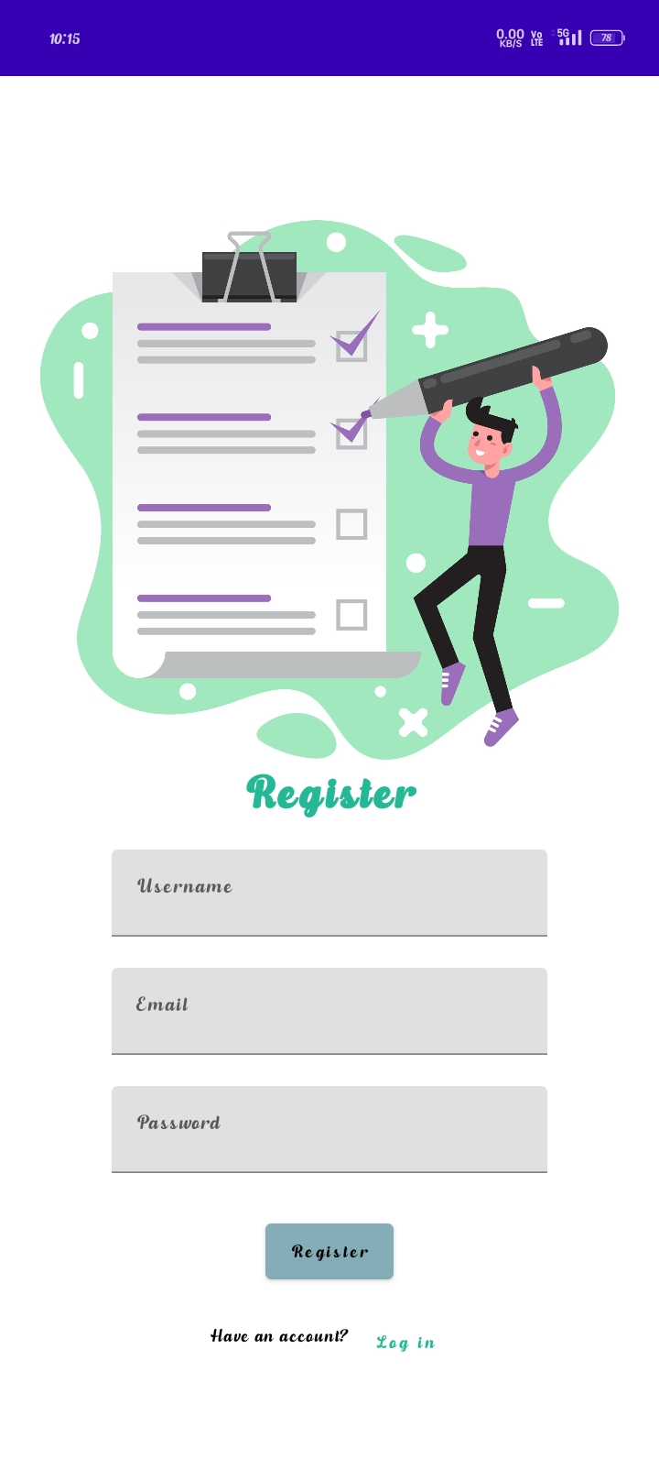

Slide 17
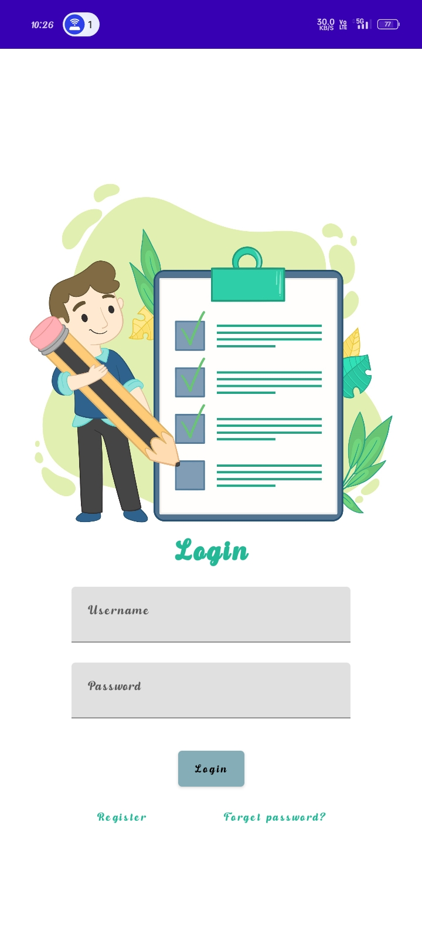

Slide 18
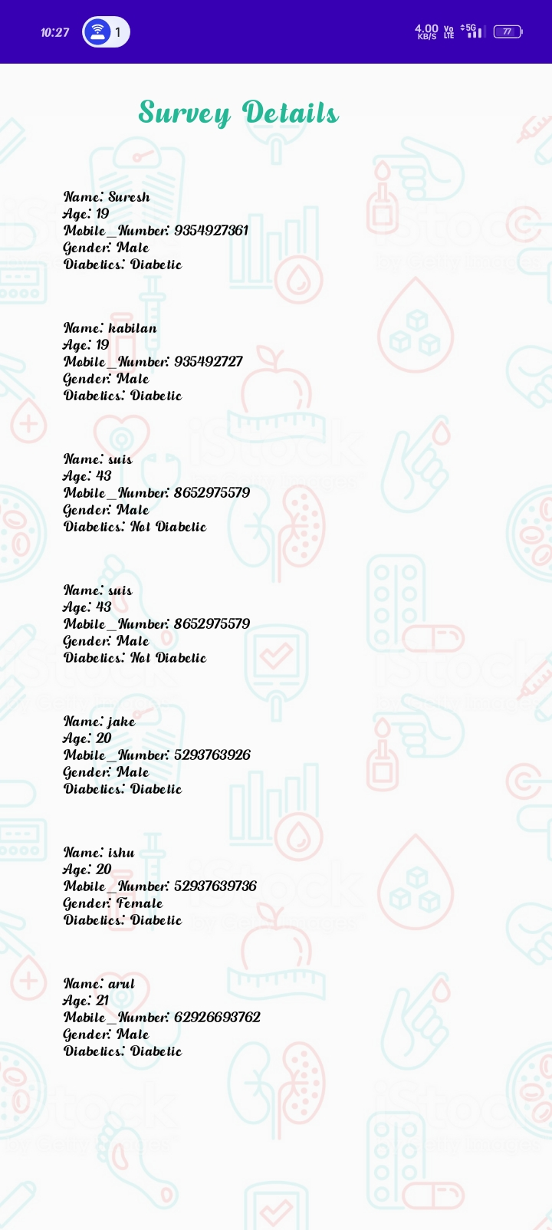

Slide 19
